Slide 1
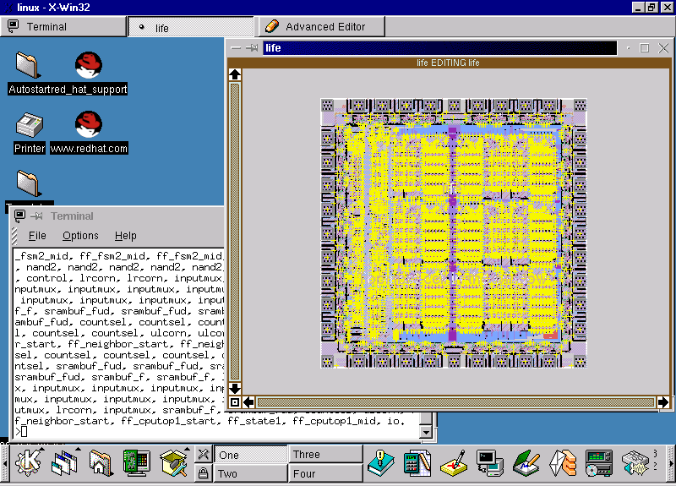


Inter-OS Migration Of
CAD Tools For IC Design
IEEE - TMU
M. B. Ghaznavi-Ghoushchi
TMU/IEEE Student Branch
2001
(C) 2001, M.B. Ghaznavi-Ghoushchi <ghaznavi@modares.ac.ir>ghaznvai@shahed.ac.ir (The only added text to ppt is my new email !!)

Slide 2
AIM
Introduction to Inter-OS Migration, including Code & Tools Migration Features, Possibilities, Cases and Using it in IC Design CAD Tools.

Slide 3

OUTLINE
1
Introduction
OS
IC Design Flows
CAD Tools & OS
Code Porting & Tool Migration
Native Code Porting
Portable Code Migration
X-Protocol ( Server/Client)
Glibc versus Cygwin
Cases Studies
Conclusion Q&A
2
3
4
5
6
7
8
9
10
11

Slide 4
OUTLINE
1
Introduction
OS
IC Design Flows
CAD Tools & OS
Code Porting & Tool Migration
Native Code Porting
Portable Code Migration
X-Protocol ( Server/Client)
Glibc versus Cygwin
Cases Studies
Conclusion Q&A

Slide 5
Introduction
Motivation
OS
*. Benefits
*. Drawbacks
Wide Spread CAD Tools
Net-Oriented CAD Tools
Technology Challenges

Slide 6
Introduction OS
Benefits
*. Price (Low-Cost)
*. High Performance
*. Multi-User
*. Network Enabled
*. Support
*. Applications Available
*. User Friendly

Slide 7
Introduction OS
Drawbacks
*. Learning Efforts
*. Week Resources
*. Non-User Friendly
*. Weak Support
*. CUI Versus GUI
*. Single User

Slide 8
Introduction Wide Spread CAD Tools
Scope of Applications
*. Physical Level
*. Transistor Level
*. Gate Level
*. Register Transfer Level
*. Sub-System Level
*. Chip Level
*. Multi-Chip Modulus
*. System Level ( Board Level)

Slide 9
Introduction Wide Spread CAD Tools
Type of Applications
*. Analog
*. Digital
*. Mixed Mode
*. MEMS
*. Electro-Optical
*. Bio-Electronics

Slide 10
Introduction Net-Oriented CAD Tools
Net-Oriented Means
*. Distributed Resources
*. Resource Sharing
*. Groupware Capability
*. Easy To Access
*. Less Implementation Effort
*. Network Spread Scope

Slide 11
Introduction Technology Challenges
Technology Challenges
*. Moore Law (DensityX2/18M)
*. Power Dissipation (Low-Power)
*. Speed (Device/System)
*. Delay/Area Constraints
*. Time To Delivery (TTD)

Slide 12
OUTLINE
Introduction
OS
IC Design Flows
CAD Tools & OS
Code Porting & Tool Migration
Native Code Porting
Portable Code Migration
X-Protocol ( Server/Client)
Glibc versus Cygwin
Cases Studies
Conclusion Q&A
2

Slide 13
Operating System
Typical OS
OS Versus OS
OS-OS Communication
OS-OS Emulation
OS-OS Migration

Slide 14
Operating System
Typical OS
*. *NIX ( UNIX Clone)
*. Main Frame Clone
*. Mac-OS
*. Windows Family
*. Linux Clone
*. Digital DEC

Slide 15
Operating System
OS Versus OS
*. *NIX ( UNIX Clone)
*. Main Frame Clone
*. Mac-OS
*. Windows Family
*. Linux Clone
*. Digital DEC

Slide 16
Operating System
UNIX Clone
*. UNIX AT&T SYS V
*. BSD Clone, NetBSD, FreeBSD
*. SunOS, Solaris
*. HP-UX
*. IBM-AIX
*. SCO, ScoWare, Xenix

Slide 17
Operating System
Windows Clone
*. Windows 9x
*. Windows NT 4 ( SRVR/WKST)
*. Windows 2000 (Win2k)
*. Windows ME
*. Windows XP ( in Beta 2001)

Slide 18

Operating System
Linux Clone
*. Debian GNU (Official Linux)
*. Redhat 6.x, 7.x ( mostly supported)
*. Mandrake ( 7.x+)( Redhat Compatible)
*. Caldera
*. SuSE
*. TurboLinux
*.LinuxPenguen ( Special for SPARC)
*., And More ...

Slide 19

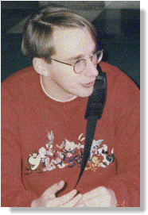

Operating System
Linux GNU Open Source O.S.
Linus-Torvalds Linux initiator

Slide 20
Operating System
What is Linux?
Linux (often pronounced LIH-nuhks with a short "i") is a UNIX-like operating system that was designed to provide personal computer users a free or very low-cost operating system comparable to traditional and usually more expensive UNIX systems. Linux has a reputation as a very efficient and fast-performing system. Linux's kernel (the central part of the operating system) was developed by Linus Torvalds at the University of Helsinki in Finland. To complete the operating system, Torvalds and other team members made use of system components developed by members of the Free Software Foundation for the GNU project.

Slide 21
Operating System
What is Linux?
Linux is a remarkably complete operating system, including a graphical user interface, X Window System, TCP/IP, the Emacs
editor, and other components usually found in a comprehensive UNIX system. Although copyrights are held by various creators
of Linux's components, Linux is distributed using the Free Software Foundation's copyleft stipulations that mean any copy is in turn freely available to others.

Slide 22
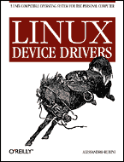


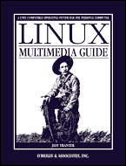
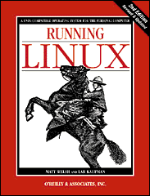
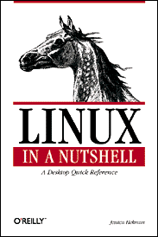
Operating System
Linux Books

Slide 23
Operating System
OS-OS Communication
*. TCP/IP
*. NetBIOS
*. NFS
*. Samba
*. NIS, NIS+
*. X-Client/Server

Slide 24
Operating System
OS-OS Emulation
*. DOSEMU for Linux
*. Merge for SCO
*. Wabi for Solaris
*. And more ...

Slide 25
Operating System
OS-OS Migration
*. What does it Mean?
*. Types of migrations
*. Scope of Usefulness
*. And more ...

Slide 26
OUTLINE
Introduction
OS
IC Design Flows
CAD Tools & OS
Code Porting & Tool Migration
Native Code Porting
Portable Code Migration
X-Protocol ( Server/Client)
Glibc versus Cygwin
Cases Studies
Conclusion Q&A
3

Slide 27
IC Design Flows
Design Categories
*. Full Custom Design
*. Semi-Custom Design
*. Automated Design
Design Flows are Customizable by
*. Needs *. Facilities *. Technical Knowledge *. Money

Slide 28
IC Design Flows
Flow-1 ( Mainly Free)
*. Verilog RTL Simulation w/vbs *. Synthesis w/vl2mv *. Optimization w/sis, espresso *. Verification w/vis *. Gate-Level Simulation w/irsim, irsim-cap *. Physical Layout w/magic, sigview w/spice3, hspice, smartspice, hsview w/spice cad, oregano *. Placement w/TimberWolfMC

Slide 29
IC Design Flows
Flow-2
*. Verilog/VHDL w/Tools from vendors Modelsim, Mentor Graphics StateCAD, Synplify, ... *. Synthesis, Optimization & Verification Xilinx, Altera, Aldec, … Leonardo Spectrum *. Physical Layout Tanner Tools L-Edit, Tspice Pro, LVS ViewLogic, WorkView Office, ...

Slide 30
IC Design Flows
Spice Circuit Simulator *. SPICE3f5 (free) *. HSPICE *. SmartSpice *. T-spice(Tanner)
VLSI Layout Editor *. Magic (free) *. L-Edit(Tanner)
Layout Vs. Schematic *. Gemini (free) *. LVS(Tanner)

Slide 31
OUTLINE
Introduction
OS
IC Design Flows
CAD Tools & OS
Code Porting & Tool Migration
Native Code Porting
Portable Code Migration
X-Protocol ( Server/Client)
Glibc versus Cygwin
Cases Studies
Conclusion Q&A
4

Slide 32
CAD Tools And OS
CAD Tools in Early Days
*. High-End Workstations
*. Complicated Setup
*. UNIX Monopoly
CAD Tools in Today
*. Low-Cost PC Systems
*. Easy to setup and run
*. RAM is cheap. CPU is Fast.
*. No Monopoly ( Is it possible?)

Slide 33
CAD Tools And OS
Efficient Programming Languages
*. C/C++ (OOP)
*. Java/VJ++ (OOP)
*. Perl
*.Tcl/TK
Cross-platform ( Platform Independent)
*. Free Compilers
*. Free Interpreters
*. Free Supports from NET

Slide 34
CAD Tools And OS
Vendors
*. Use portable programming tools
*. Deliver codes for major OS’s
*. Offer GUI than CUI
Major CAD OS platforms
*. Sun’s Solaris ( Historically)
*. Ms Windows ( NT, 9X)
*. Linux ( Growing Fast)

Slide 35
CAD Tools And OS
CAD Tools Security/Copyright
*. Hostid/Host license
*. Physical Dangle
*. Registration Code
*. Time-limited features
*. Evaluation/Student Versions
*. Academic Discount
*. Network update(!!)

Slide 36
OUTLINE
Introduction
OS
IC Design Flows
CAD Tools & OS
Code Porting & Tool Migration
Native Code Porting
Portable Code Migration
X-Protocol ( Server/Client)
Glibc versus Cygwin
Cases Studies
Conclusion Q&A
5

Slide 37
Code Porting & Tool Migration
Code Porting / Tool Migration *. Importance *. Feasibility *. Scope
Types of Porting *. Native (Code/Tool) Migration *. Portable (Code/Tool) Migration
Desired Operating Systems *. Linux *. Ms Windows ( Specially NT)

Slide 38
OUTLINE
Introduction
OS
IC Design Flows
CAD Tools & OS
Code Porting & Tool Migration
Native Code Porting
Portable Code Migration
X-Protocol ( Server/Client)
Glibc versus Cygwin
Cases Studies
Conclusion Q&A
6

Slide 39
Native Code Porting
Native Migration Types
*. From Linux To Windows
*. From Windows To Linux
*. X-Based Applications
*. Glibc & Cygwin

Slide 40
Native Code Porting
Wine Is Not an Emulator ( Command Line)
Vmware Virtual Machine Tools ( GUI)
Win4Lin ( Aka Merge for SCO) Windows For Linux ( Full Featured)

Slide 41
Native Code Porting
Easy of Installation
1. Wine, Win4lin 2. VMware
Supported Features
1. Win4lin 2. Vmware 3. Wine
Reliability
1. Win4lin 2. Vmware 3. Wine
Result: Win4Lin is the better choice.

Slide 42
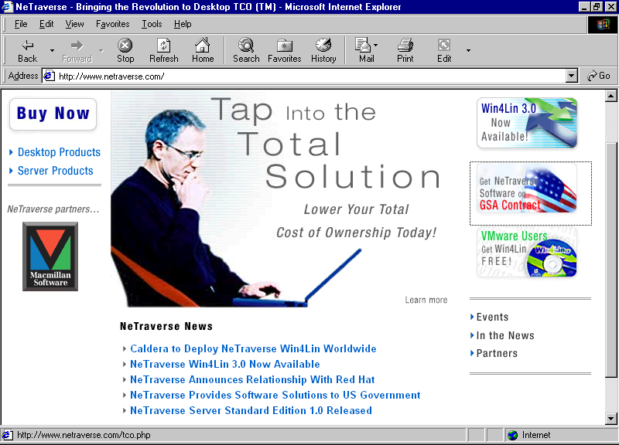
Native Code Porting
Ref: http://www.netraverse.com

Slide 43
Intentionally Blank Page

Slide 44
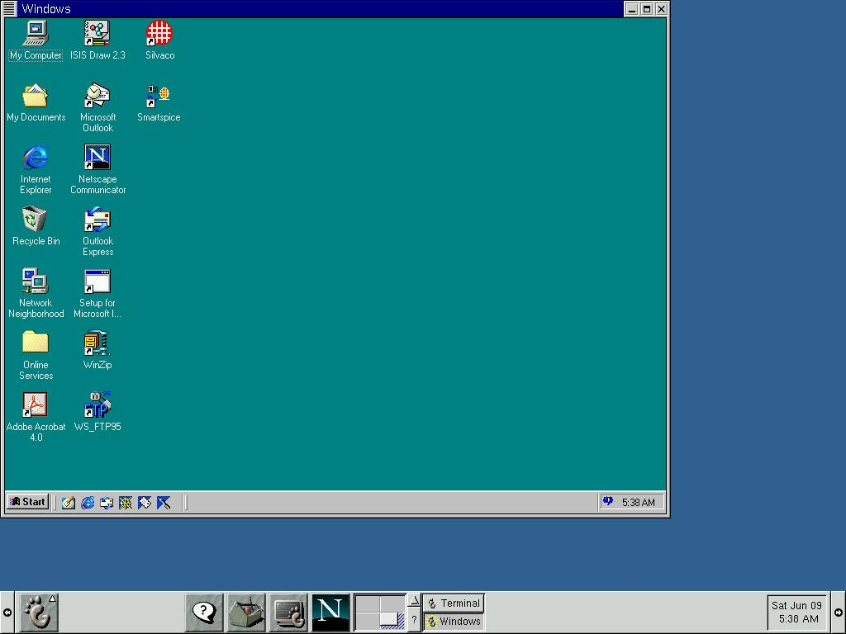
Native Code Porting

Slide 45
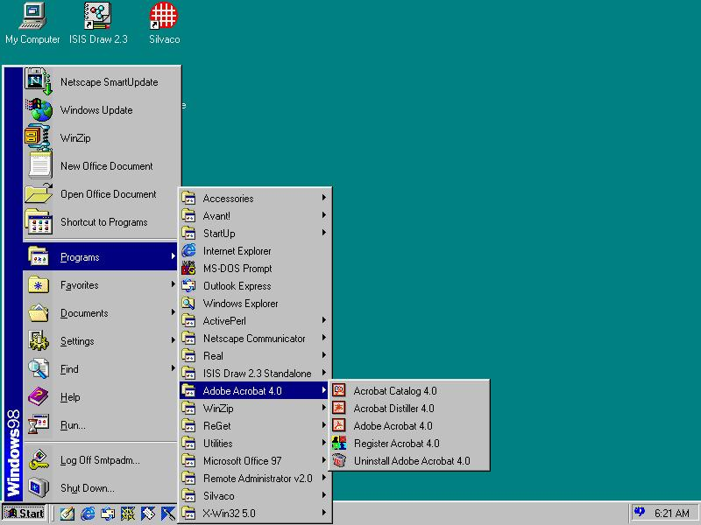
Native Code Porting

Slide 46
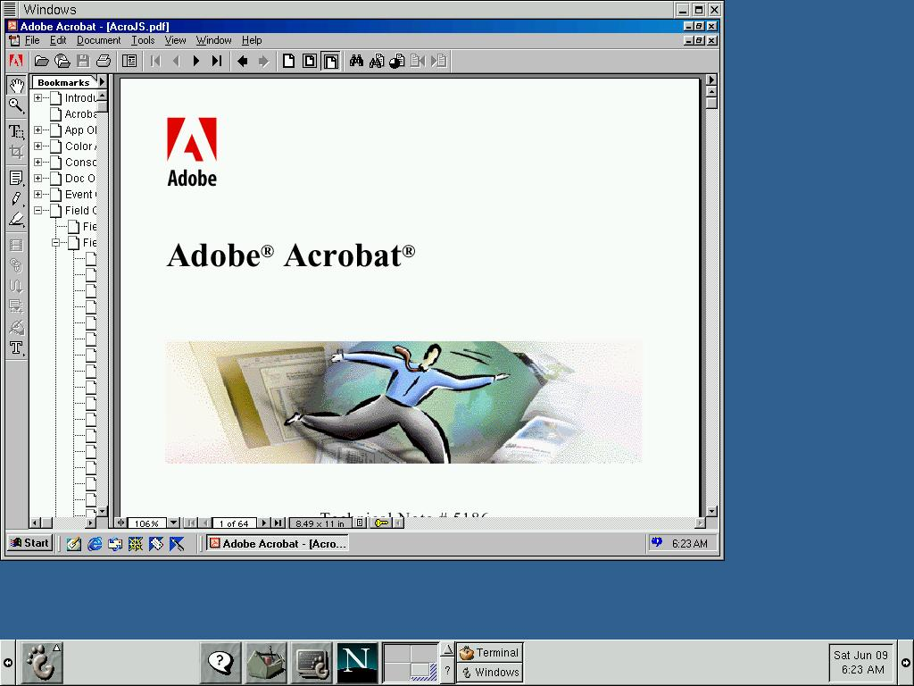
Native Code Porting

Slide 47
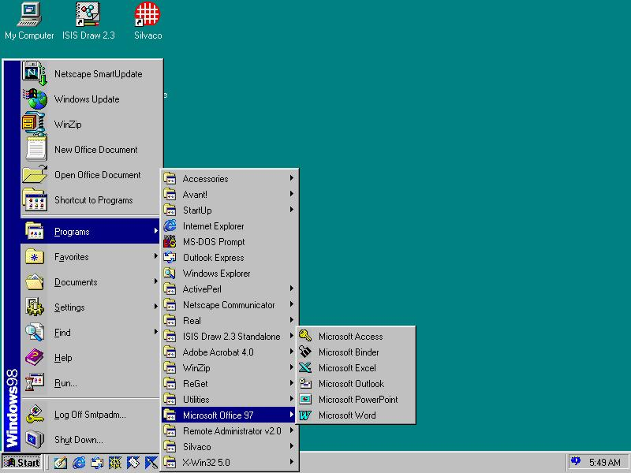
Native Code Porting

Slide 48
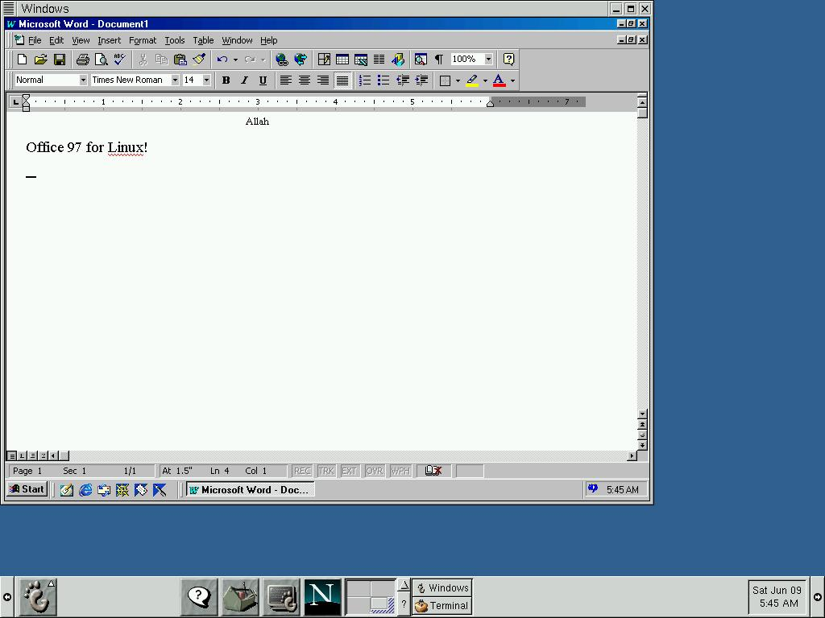
Native Code Porting

Slide 49
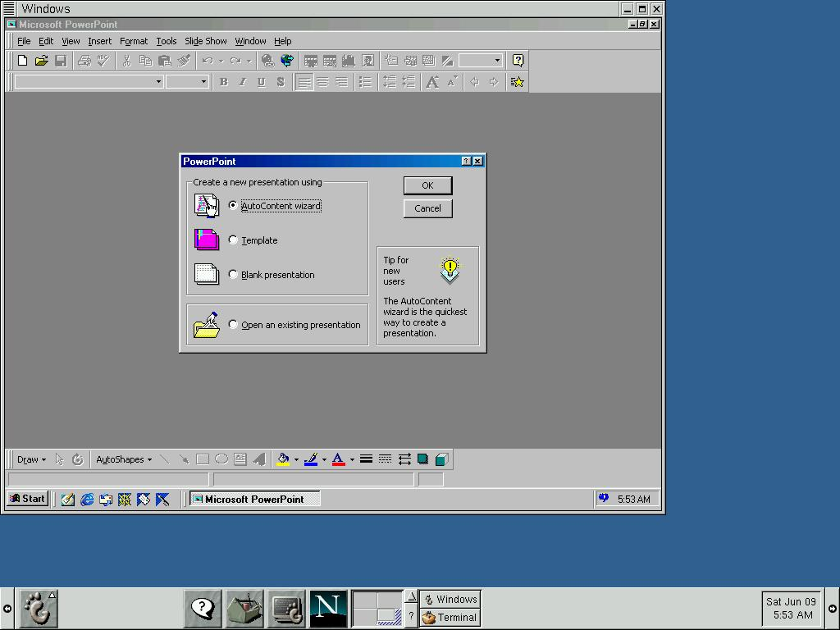
Native Code Porting

Slide 50
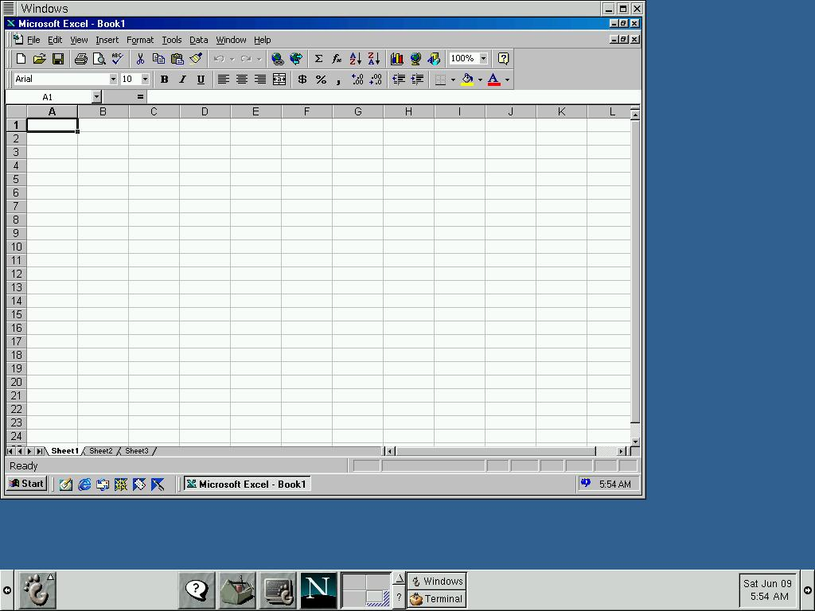
Native Code Porting

Slide 51
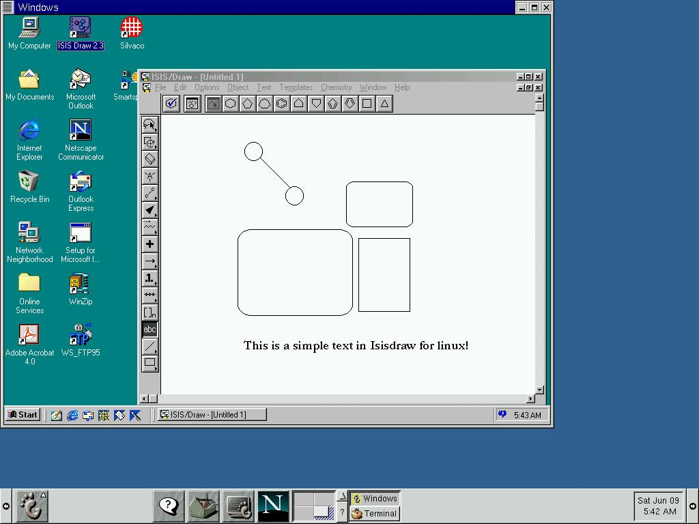
Native Code Porting

Slide 52
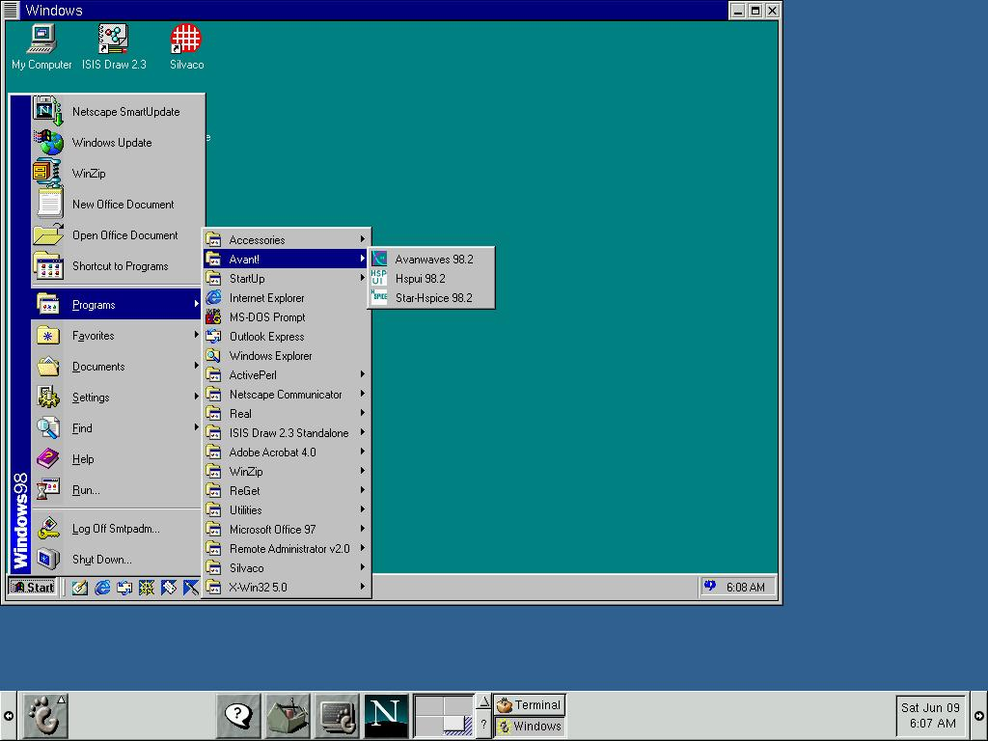
Native Code Porting

Slide 53
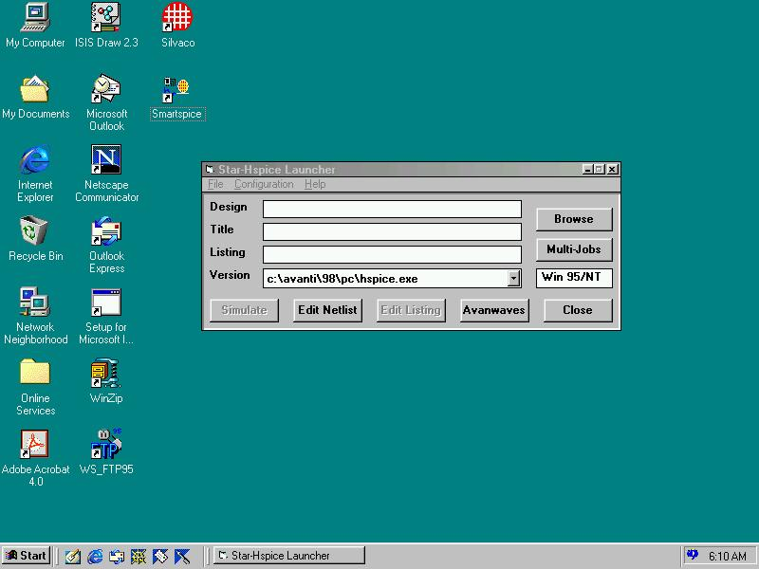
Native Code Porting

Slide 54
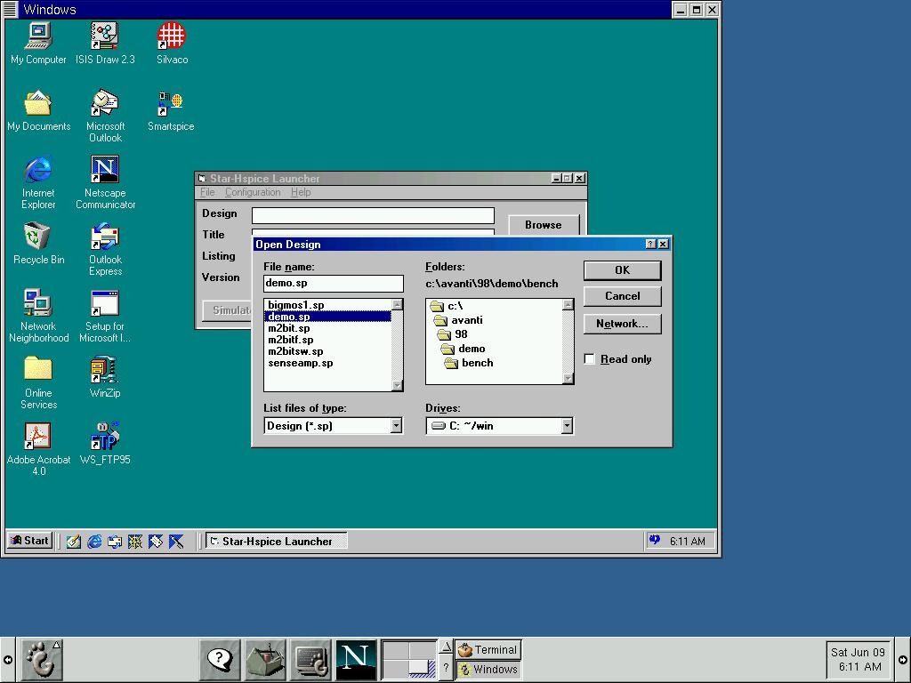
Native Code Porting

Slide 55
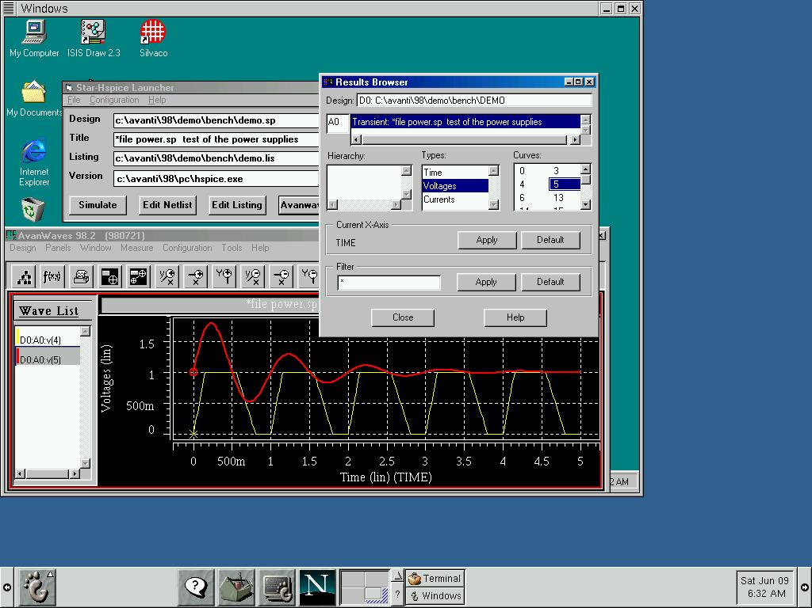
Native Code Porting

Slide 56
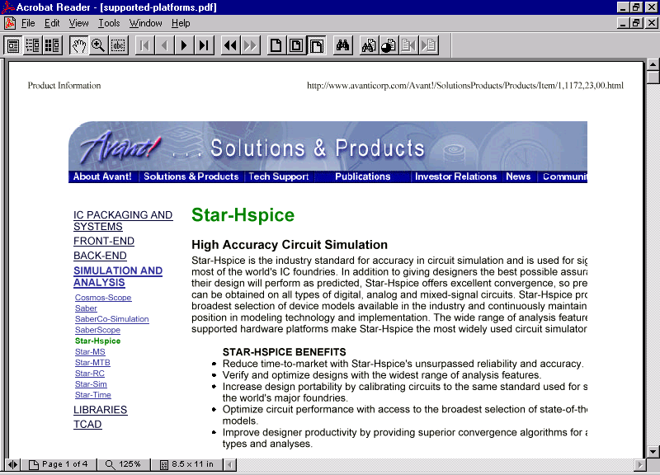
Native Code Porting

Slide 57
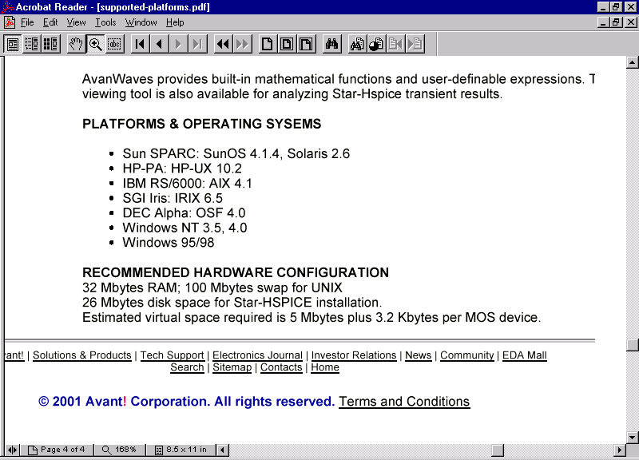
Native Code Porting
Ref: http://www.avanticorp.com/Avant!/SolutionsProducts/Products/Item/1,1172,23,00.html

Slide 58
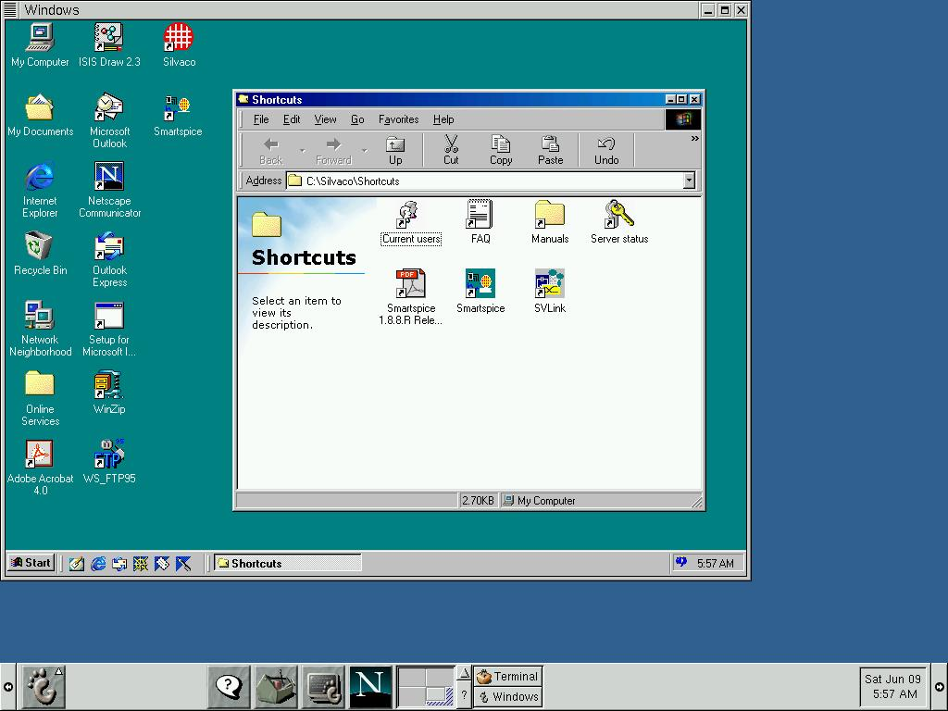
Native Code Porting

Slide 59
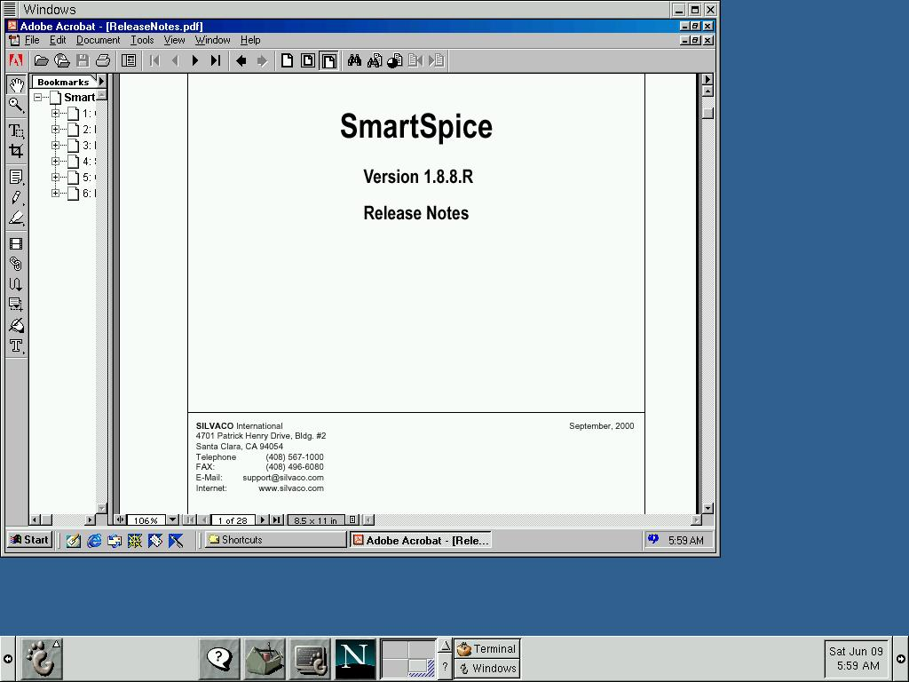
Native Code Porting

Slide 60
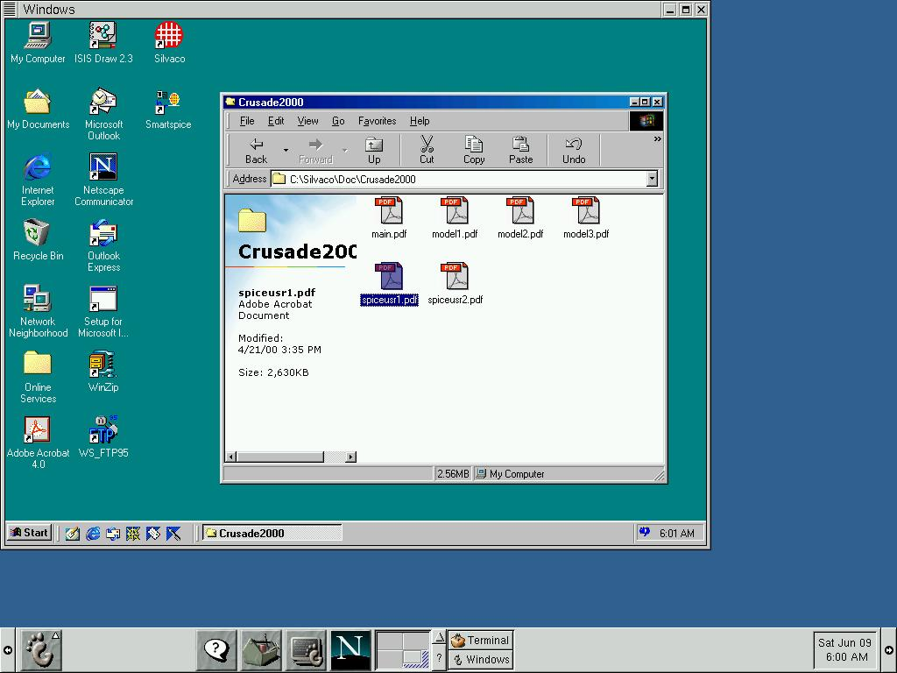
Native Code Porting

Slide 61

Native Code Porting

Slide 62
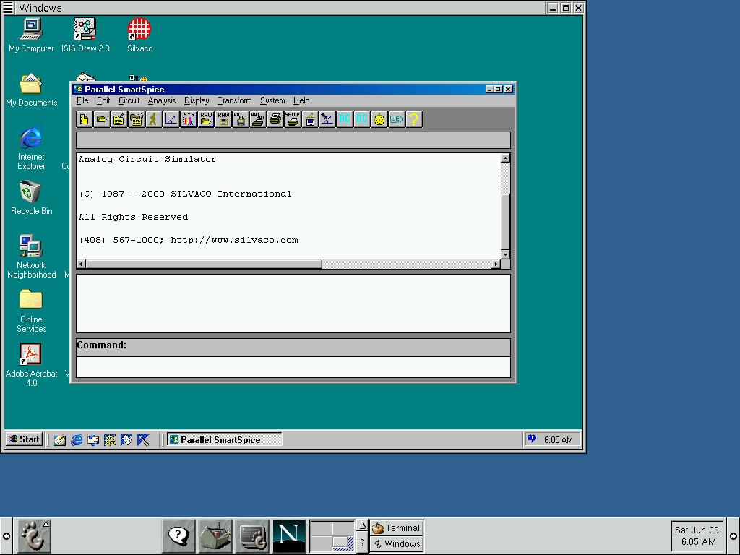
Native Code Porting

Slide 63
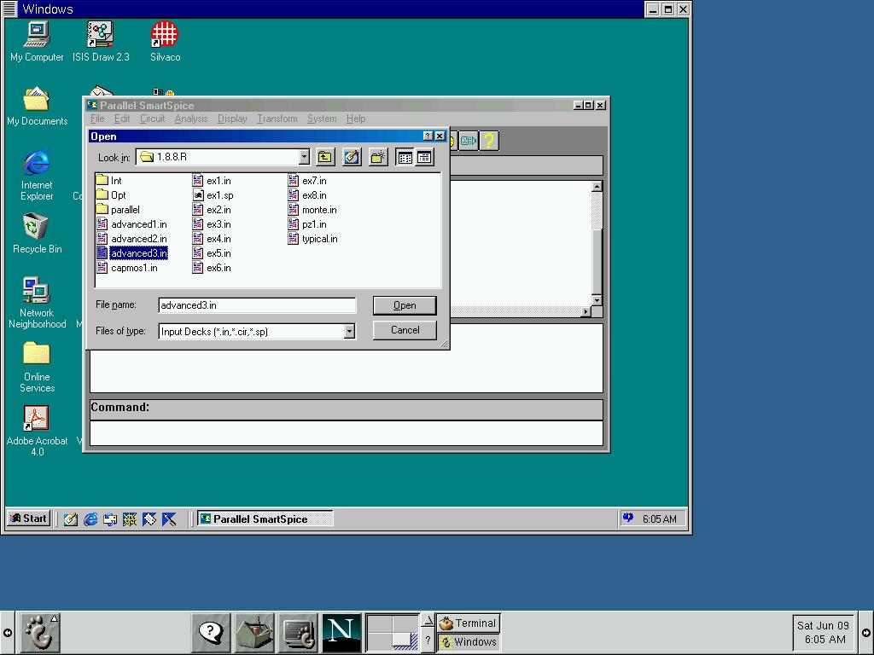
Native Code Porting

Slide 64
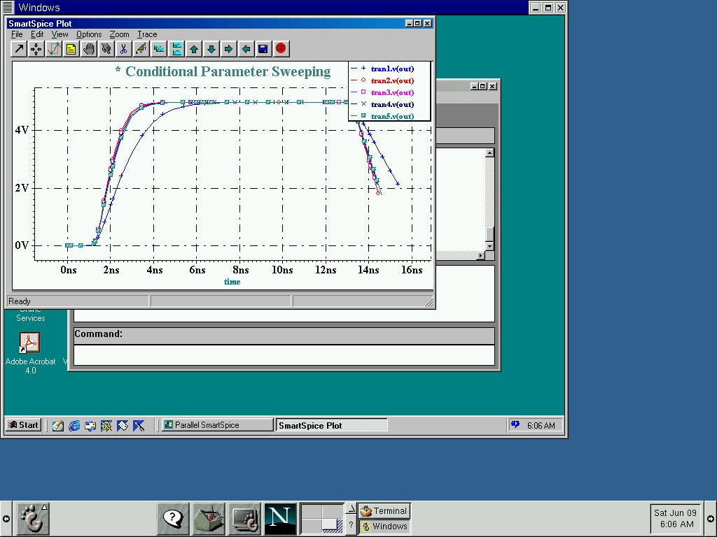
Native Code Porting

Slide 65
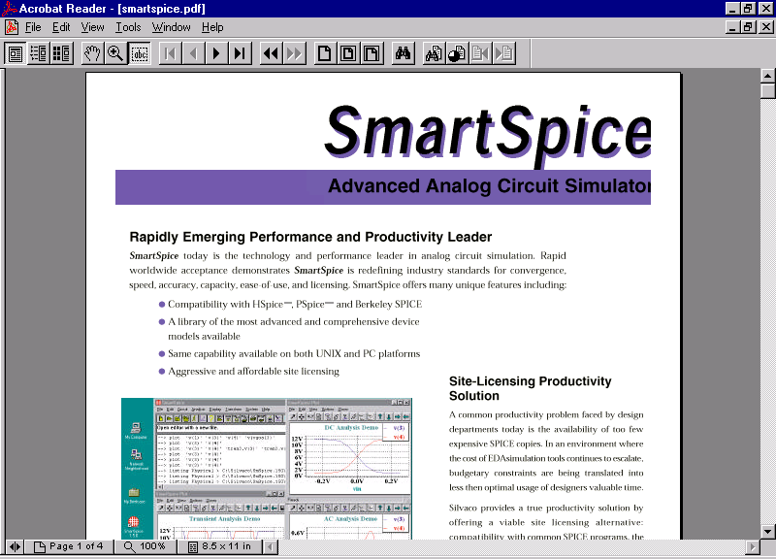
Native Code Porting

Slide 66
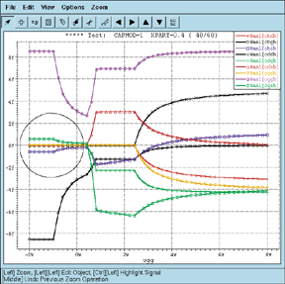
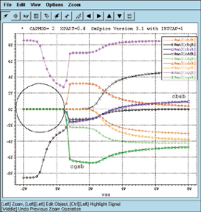
Commitment to the BSIM3v3 MOS Model in Smart-Spice
BSIM3v3 is becoming widely recognized as the best physics-based deep sub-micron MOSFET model for analog and digital design. While fully supporting Berkeley's BSIM3v3.1, Silvaco also offers unique enhancements to both the physical model as
well as the numerical implementation of the model.
Silvaco's BSIM3v3 solves a number of problems present in the Berkeley model. Among these are solutions related to non-physical capacitances and the inclusion of an enhanced impact ionization current model for short and long channel devices.
Negative capacitances present in the Berkeley BSIM3V3 Model.
Correct Silvaco implementation.

Slide 67
Native Code Porting
Waiting time for startup of Smartspice. File size=10,694,656 bytes
311
7

Slide 68


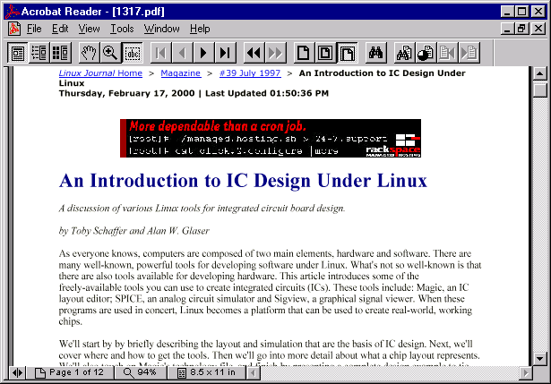
A discussion of various Linux tools for integrated circuit board design.
by Toby Schaffer and Alan W. Glaser
Ref: http://www2.linuxjournal.com/lj-issues/issue39/1317.html

Slide 69
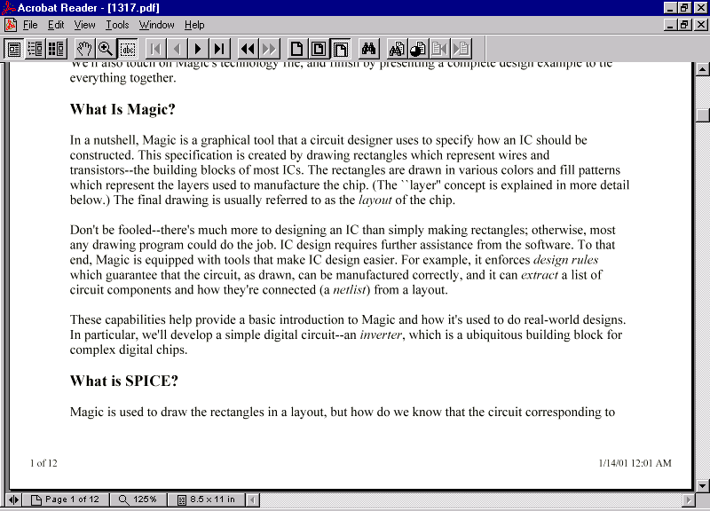
Native Code Porting
Ref: http://www2.linuxjournal.com/lj-issues/issue39/1317.html

Slide 70
Native Code Porting + X
X-Client/Server based code migration
X from Linux to Win32 has many options
Glibc of Linux and Cygwin of Win32

Slide 71
Native Code Porting
X-Client/Server Protocol acts via TCP/IP
X spreads on Internet/Intranet
Xdm is X-Daemon, and X is Client program
This architecture is OS-Independent

Slide 72
Native Code Porting

Slide 73
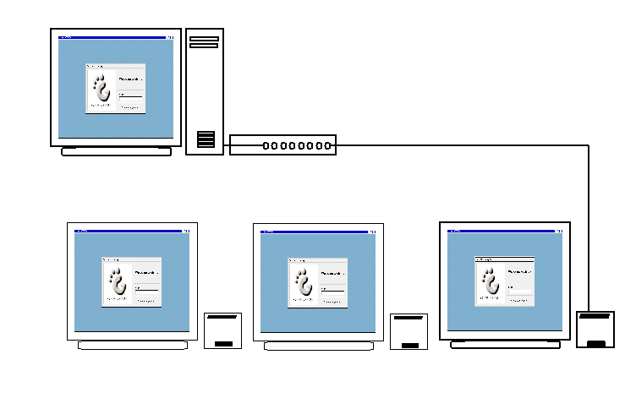
Native Code Porting

Slide 74
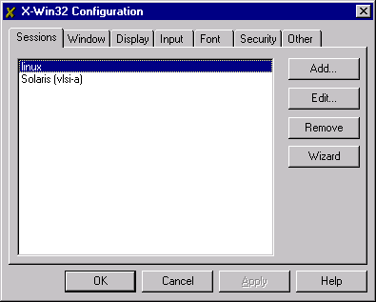
Native Code Porting

Slide 75
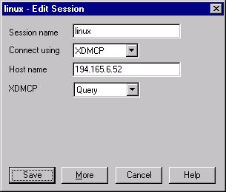
Native Code Porting

Slide 76
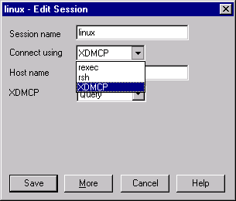
Native Code Porting

Slide 77
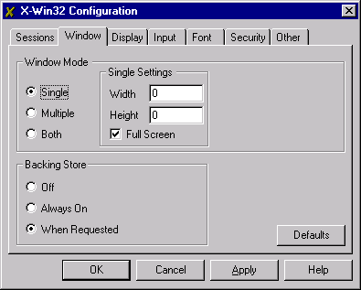
Native Code Porting

Slide 78
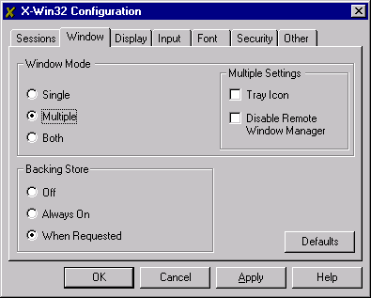
Native Code Porting

Slide 79
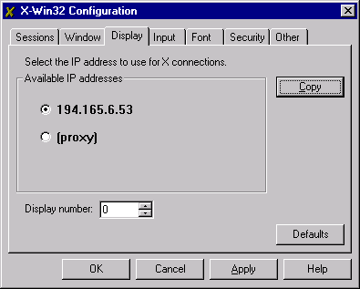
Native Code Porting

Slide 80
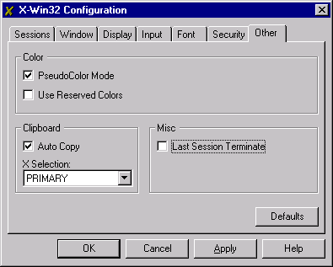
Native Code Porting

Slide 81
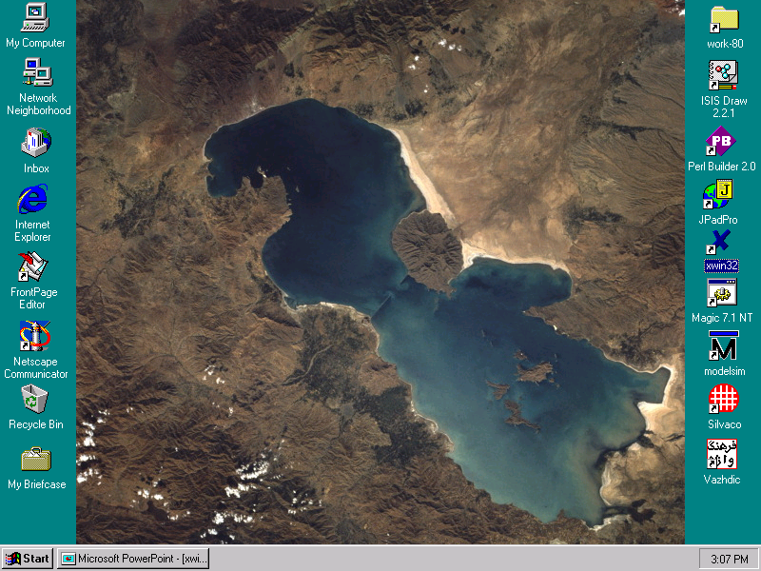
Native Code Porting

Slide 82
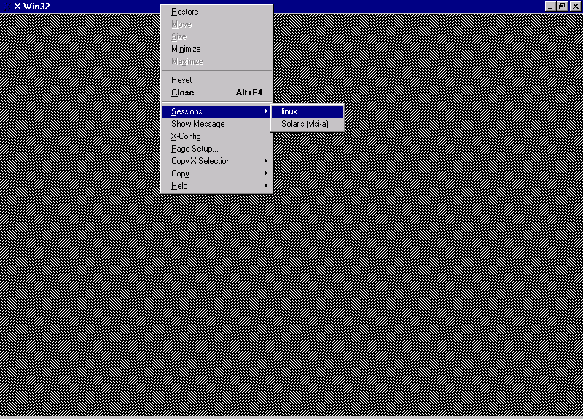
Native Code Porting

Slide 83
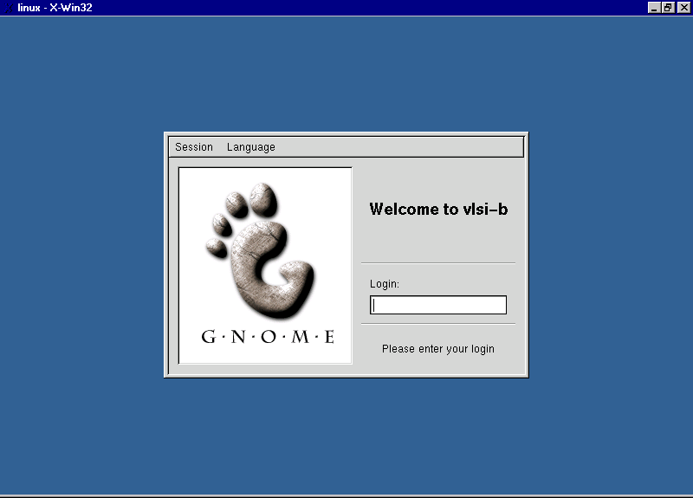
Native Code Porting

Slide 84
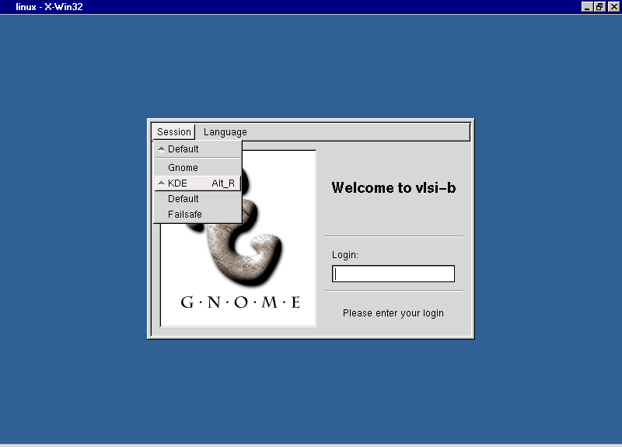
Native Code Porting

Slide 85
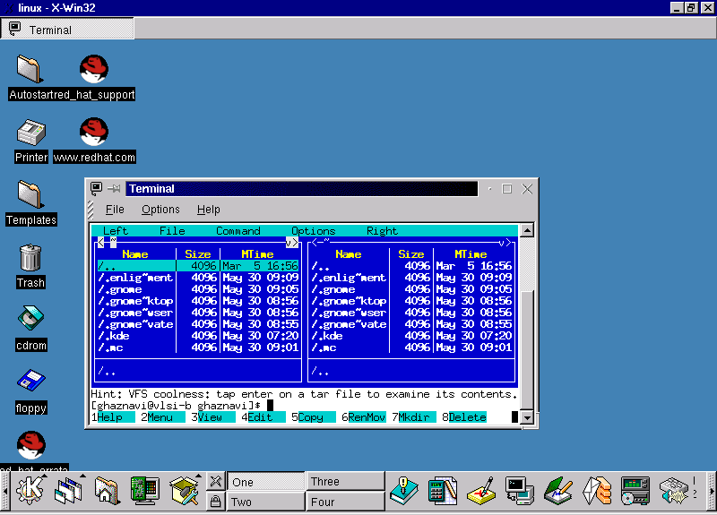
Native Code Porting

Slide 86
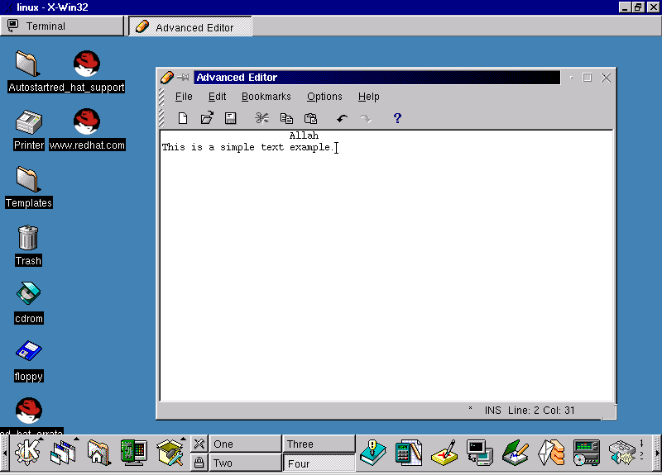
Native Code Porting

Slide 87
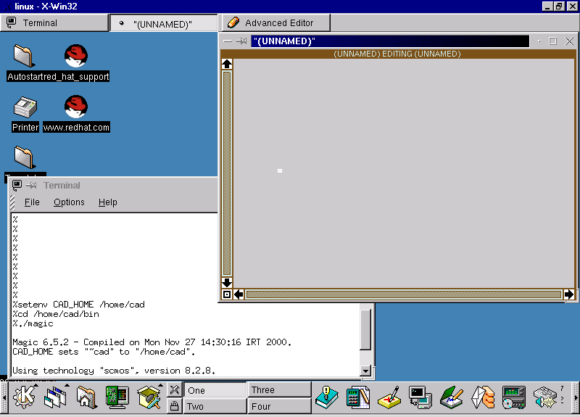
Native Code Porting

Slide 88
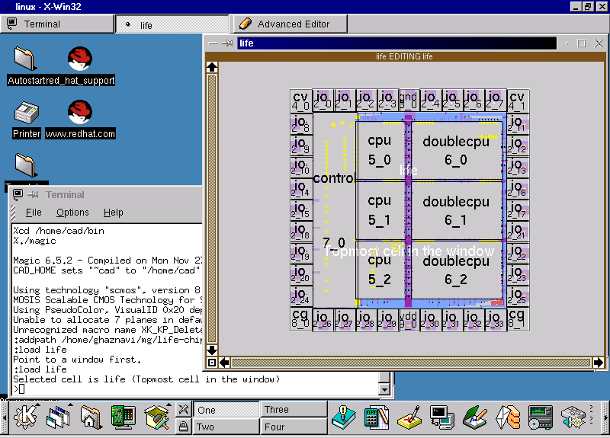
Native Code Porting

Slide 89
Native Code Porting

Slide 90
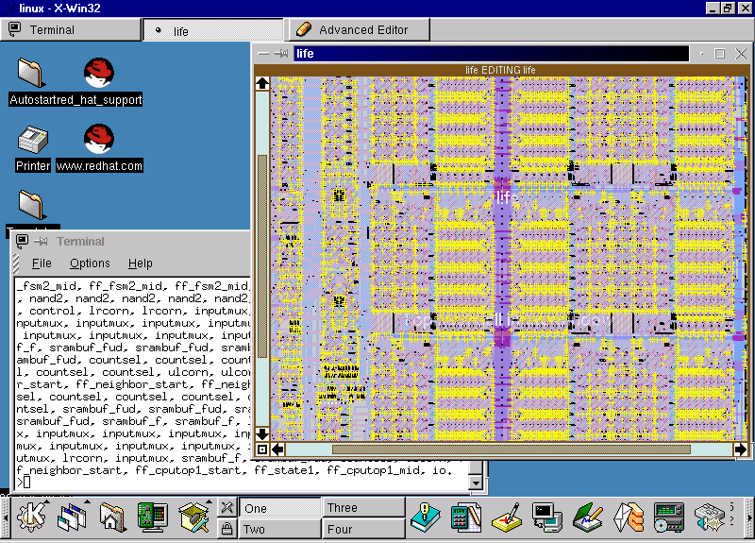
Native Code Porting

Slide 91
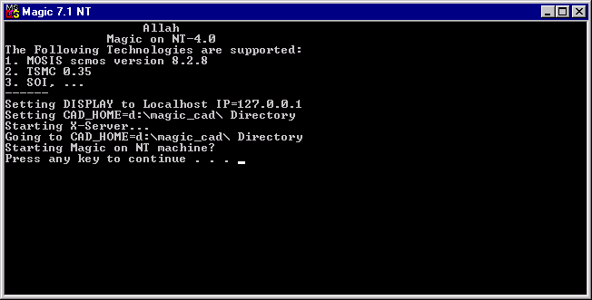
Native Code Porting

Slide 92

Native Code Porting

Slide 93

Native Code Porting

Slide 94

Native Code Porting

Slide 95

Native Code Porting

Slide 96
OUTLINE
Introduction
OS
IC Design Flows
CAD Tools & OS
Code Porting & Tool Migration
Native Code Porting
Portable Code Migration
X-Protocol ( Server/Client)
Glibc versus Cygwin
Cases Studies
Conclusion Q&A
7

Slide 97
Portable Code Porting
Portable Migration Types
*. Java
*. Perl
*. Tcl/Tk

Slide 98
Portable Code Porting
Java Code Is Portable Code.

Slide 99
Portable Code Porting
Java Codes are in ByteCode NOT in Machine code

Slide 100

Portable Code Porting
Using Java As:
*. Java Applet ( Via web)
*. Java Application (Via java)
*. Java Servlet ( Via web)
Java Applet Runs on Client Side
Java Servlet Runs on Server Side
Java Applications Runs as Normal Application

Slide 101



Java
Portable Code Porting
James Gosling

Slide 102
What is Java?
Portable Code Porting
Java is a programming language expressly designed for use in the distributed environment of the Internet.
It was designed to have the "look and feel" of the C++ language, but it is simpler to use than C++ and enforces a completely object-oriented view of programming. Java can be used to create complete applications that may run on a single computer or be distributed among servers and clients in a network.
It can also be used to build small application modules or applets for use as part of a Web page. Applets make it possible for a Web page user to interact with the page.

Slide 103
History of Java?
Portable Code Porting
Java was introduced by Sun Microsystems in 1995 and instantly created a new sense of the interactive possibilities of the Web.
Both of the major Web browsers include a Java virtual machine. Almost all major operating system developers (IBM,
Microsoft, and others) have added Java compilers as part of their product offerings.

Slide 104
Java Virtual Machine
Portable Code Porting
The Java virtual machine includes an optional just-in-time (JIT) compiler that dynamically compiles bytecode into executable code as an alternative to interpreting one bytecode instruction at a time. In many cases, the dynamic JIT compilation is faster than the virtual machine interpretation.

Slide 105
Java and Javascript
Portable Code Porting
JavaScript should not be confused with Java. JavaScript, which originated at Netscape, is interpreted at a higher level, is easier to learn than Java, but lacks some of the portability of Java and the speed of bytecode. Because Java applets will run on almost any operating system without requiring recompilation and because Java has no operating system-unique extensions or variations, Java is generally regarded as the most strategic language in which to develop applications for the Web. (However, JavaScript can be useful for very small applications that run on the Web client or server.) .

Slide 106
The major characteristics of Java
Portable Code Porting
The programs you create are portable in a network. Your program is compiled into Java bytecode that can be run anywhere in a network on a server or client that has a Java virtual machine. The Java virtual machine interprets the bytecode into code that will run on the real computer hardware. This means that individual computer platform differences such as instruction lengths can be recognized and accommodated locally just as the program is being executed. Platform-specific versions of your program are no longer needed.

Slide 107
The major characteristics of Java
Portable Code Porting
The code is "robust," here meaning that, unlike programs written in C++ and perhaps some other languages, the Java objects can contain no references to data external to themselves or other known objects. This ensures that an instruction can not contain the address of data storage in another application or in the operating system itself, either of which would cause the program and perhaps the operating system itself to terminate or "crash." The Java virtual machine makes a number of checks on each object to ensure integrity.

Slide 108
The major characteristics of Java
Portable Code Porting
Java is object-oriented, which means that, among other characteristics, similar objects can take advantage of being part of the same class and inherit common code. Objects are thought of as "nouns" that a user might relate to rather than the traditional procedural "verbs." A method can be thought of as one of the object's capabilities or behaviors.

Slide 109
The major characteristics of Java
Portable Code Porting
In addition to being executed at the client rather than the server, a Java applet has other characteristics designed to make it run fast.
Relative to C++, Java is easier to learn. (However, it is not a language you'll pick up in an evening!)

Slide 110
The Java Chip
Portable Code Porting
The Java chip is a microchip that, when included in or added to a computer, will enable the execution of or accelerate the performance of Java programs (including the applets that can be sent along with a Web page).
The Java chip may also be used to run applications in small electronic appliances such as organizers, pagers, and cell phones.

Slide 111

Portable Code Porting

Slide 112

Portable Code Porting

Slide 113
Intentionally Blank Page

Slide 114

Portable Code Porting

Slide 115

Portable Code Porting

Slide 116

Portable Code Porting

Slide 117

Portable Code Porting

Slide 118

Portable Code Porting

Slide 119

Portable Code Porting

Slide 120

Portable Code Porting

Slide 121

Portable Code Porting

Slide 122

Portable Code Porting

Slide 123

Portable Code Porting

Slide 124

Portable Code Porting

Slide 125

Portable Code Porting

Slide 126

Portable Code Porting

Slide 127

Portable Code Porting

Slide 128

Portable Code Porting

Slide 129

Portable Code Porting

Slide 130

Portable Code Porting

Slide 131

Portable Code Porting

Slide 132

Portable Code Porting

Slide 133

Portable Code Porting

Slide 134

Portable Code Porting

Slide 135

Portable Code Porting

Slide 136

Portable Code Porting

Slide 137

Portable Code Porting

Slide 138

Portable Code Porting

Slide 139

Portable Code Porting

Slide 140

Portable Code Porting

Slide 141

Portable Code Porting

Slide 142

Portable Code Porting

Slide 143


Portable Code Porting

Slide 144


Portable Code Porting

Slide 145
Portable Code Porting
Java is Great!

Slide 146

Portable Code Porting
Perl belongs to Scripting Languages

Slide 147

Portable Code Porting
Using Perl As:
*. Perl Script (Normal)
*. Executable Code ( Special)
*. ASP-PerlScript ( Via Web)
Perl in normal mode is a text script file
Exceutable mode is better for code security
ASP-PerlScript is good for web applications

Slide 148

Perl Practical Extraction Reporting Language
Portable Code Porting
Larry Wall Creator of Perl

Slide 149
Portable Code Porting
Perl is a script programming language that is similar in syntax to the C language and that includes a number of popular UNIX facilities such as sed, awk, and tr. Perl is an interpreted language that can be compiled just before execution into either C code or cross-platform byte-code. When compiled, a Perl program is almost (but not quite) as fast as a fully precompiled C language program. Perl is regarded as a good choice for developing Common Gateway Interface (CGI) programs because it has good text manipulation facilities (although it also handles binary files). It was invented by Larry Wall.
In general, Perl is easier to learn and faster to code in than the more structured C and C++ languages.
Perl programs can, however, be quite sophisticated. Perl tends to have devoted adherents.

Slide 150

Portable Code Porting

Slide 151











Perl Books
Portable Code Porting

Slide 152
Portable Code Porting

Slide 153

Portable Code Porting

Slide 154

Portable Code Porting

Slide 155

Portable Code Porting

Slide 156

Portable Code Porting

Slide 157

Portable Code Porting

Slide 158


Portable Code Porting

Slide 159


Portable Code Porting

Slide 160

Portable Code Porting

Slide 161

Portable Code Porting

Slide 162

Portable Code Porting

Slide 163


Portable Code Porting

Slide 164

Portable Code Porting

Slide 165

Portable Code Porting

Slide 166

Portable Code Porting

Slide 167
Portable Code Porting
Tcl/Tk is Tools Command Language

Slide 168

Portable Code Porting
Using Tcl/Tk As:
*. Tcl/Tk Script (Normal)
*. Executable Code ( Special)
*. Tclet ( Via Web)
Tcl/Tk in normal mode is a text script file
Exceutable mode is better for code security
Tclet runs via web ( by web browser)

Slide 169



Tcl/Tk
Portable Code Porting
John Ousterhout

Slide 170
Portable Code Porting
The birth of Tcl
The Tcl scripting language grew out of Ousterhout work on design tools for integrated circuits at the University of California at Berkeley in the early 1980's. His students and he had written several interactive tools for IC design, such as Magic and Crystal. Each tool needed to have a command language (in those days people tended to invoke tools by typing commands; graphical user
interfaces weren't yet in widespread use). However, Their primary interest was in the tools, not their command languages. Thus
they didn't invest much effort in the command languages and the languages ended up being weak and quirky. Furthermore, the
language for one tool couldn't be carried over to the next, so each tool ended up with a different bad command language. After
a while this became rather embarrassing.

Slide 171

Portable Code Porting

Slide 172
What is Tcl?
Portable Code Porting
Tcl is an interpreted script language developed by Dr. John Ousterhout at the University of California, Berkeley, and now developed and maintained by Scriptics. In general, script languages are easier and faster to code in than the more structured, compiled languages such as C and C++.
Script languages are sometimes considered good "glue" languages for tying several compiled programs together. Or, as
stand-alone programs, they can allow you to create simple but powerful effects on their own. TclBlend is a version of Tcl that can access certain Java language facilities.

Slide 173
What is Tk?
Portable Code Porting
Tcl has a companion program, Tk (Tool Kit), to help create a graphical user interface with Tcl. Tk is a companion program to Tcl for creating graphical user interfaces. Together with Tcl, Tk is a rapid program development tool from Scriptics. Both can be ordered from the Scriptics Web site.
Tk provides a collection of standard buttons, menus, listboxes, and scrollbars and two special features, the text widget and the canvas widget, that the Tcl programmer can use to speed up program
development.

Slide 174

Portable Code Porting

Slide 175

Portable Code Porting

Slide 176

Portable Code Porting

Slide 177

Portable Code Porting

Slide 178

Portable Code Porting

Slide 179







Tcl/Tk Books
Portable Code Porting

Slide 180

Portable Code Porting
Tcl/Tk Developing Team

Slide 181


Portable Code Porting

Slide 182

Portable Code Porting

Slide 183

Portable Code Porting

Slide 184

Portable Code Porting

Slide 185

Portable Code Porting

Slide 186

Portable Code Porting

Slide 187

Portable Code Porting

Slide 188

Portable Code Porting

Slide 189

Portable Code Porting
VGUI: VHDL - Graphic User Interface
Ref: http://www.atl.external.lmco.com/rassp/vgui/
Free for Download

Slide 190

Portable Code Porting

Slide 191

Portable Code Porting

Slide 192

Portable Code Porting

Slide 193

Portable Code Porting

Slide 194

Portable Code Porting

Slide 195

Portable Code Porting

Slide 196
Generated VHDL
Generated Verilog
----------------------------------------------------------------------------
-- VHDL EXPORT File: D:\source\vgui\ff.vhdl -
----------------------------------------------------------------------------
ENTITY MS_FlipFlop IS
PORT( Clock : IN bit;
Qbar, Q : OUT bit;
R, S : IN bit
);
END MS_FlipFlop;
ARCHITECTURE structure OF MS_FlipFlop IS
SIGNAL L2, L3, L4, L7 : bit;
COMPONENT RS_FlipFlop
PORT( Q, Qbar : OUT bit;
clock, Clear, Preset, Reset, Set : IN bit
);
END COMPONENT;
COMPONENT Invertor
PORT( o1 : OUT bit;
a : IN bit
);
END COMPONENT;
COMPONENT passthrough
PORT( in : IN bit;
o1 : OUT bit
);
END COMPONENT;
BEGIN
RS1 : RS_FlipFlop
PORT MAP( L4, L3, L2, null, null, R, S );
RS2 : RS_FlipFlop
PORT MAP( Q, Qbar, L7, null, null, L3, L4 );
Negate1 : Invertor
PORT MAP( L7, L2 );
pass : passthrough
PORT MAP( Clock, L2 );
END structure; , ...
//---------------------------------------------------------------------------
// Verlog EXPORT File: D:\source\vgui\ff.vlg -
//---------------------------------------------------------------------------
module MS_FlipFlop ( Clock, Qbar, Q, R, S );
input Clock, R, S;
output Qbar, Q;
wire L0, L1, L2, L3, L4, L5, L6, L7, L8, L9;
RS_FlipFlop RS1( L4, L3, L2, null, null, R, S );
RS_FlipFlop RS2( Q, Qbar, L7, null, null, L3, L4 );
Invertor Negate1( L7, L2 );
passthrough pass( Clock, L2 );
endmodule // MS_FlipFlop
module RS_FlipFlop ( Q, Qbar, clock, Clear, Preset, Reset, Set );
input clock, Clear, Preset, Reset, Set;
output Q, Qbar;
wire L0, L1, L2, L3, L4, L5, L6, L7, L8, L9, L10,
L11, L12, L13, L14;
AND_2in And1( L4, L2, Set );
AND_2in And2( L5, L2, Reset );
NOR_3in Nor1( L8, L9, Preset, L4 );
NOR_3in Nor2( L9, Clear, L8, L5 );
passthrough pass( clock, L2 );
passthrough pass1( L8, Qbar );
passthrough pass2( L9, Q );
endmodule // RS_FlipFlop
,...

Slide 197


Portable Code Porting

Slide 198

Portable Code Porting

Slide 199


Portable Code Porting

Slide 200


Portable Code Porting

Slide 201

Portable Code Porting

Slide 202
OUTLINE
Introduction
OS
IC Design Flows
CAD Tools & OS
Code Porting & Tool Migration
Native Code Porting
Portable Code Migration
X-Protocol ( Server/Client)
Glibc versus Cygwin
Cases Studies
Conclusion Q&A
8
9
10

Slide 203
OUTLINE
X-Protocol ( Server/Client)
Glibc versus Cygwin
Cases Studies These Three parts have been Survived explicitly In the Presentation. :-)

Slide 204
OUTLINE
Introduction
OS
IC Design Flows
CAD Tools & OS
Code Porting & Tool Migration
Native Code Porting
Portable Code Migration
X-Protocol ( Server/Client)
Glibc versus Cygwin
Cases Studies
Conclusion Q&A
11

Slide 205
Conclusion
Low-Cost, High performance, Reliable IC Design Lab. is achievable.
LINUX/Windows Combination is the best Choice..
Java, Perl, Tcl/Tk are suitable programming languages.

Slide 206


Conclusion
Sun/Solaris/Tatung
Linux/RedHat 6.1
Windows NT 4

Slide 207
Q & A
?

